Slide 1
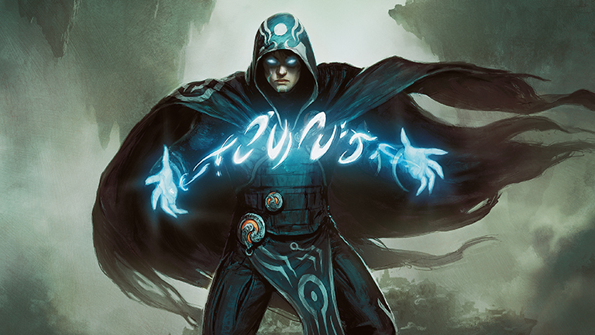
The People’s Cube
Player’s Guide

Slide 2
Cube Philosophy and Table of Contents
The People’s Cube offers a vintage power level experience with a focus on contemporary gameplay, competitive balance, and rich replayability. This guide offers a brief preview into a few of the archetypes supported.
White Aggro
Green Ramp
Blue Control
Lands
Domain
Shops
Blue Artifacts
Reanimator
Wheel Combo
Storm Combo
Creature Combo
Recent Additions

Slide 3


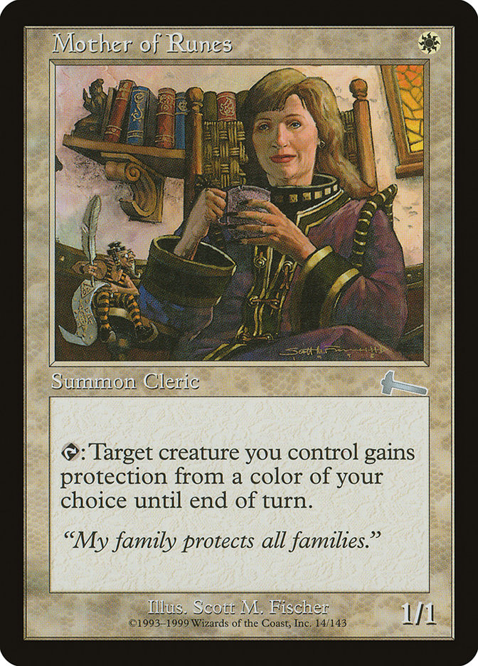
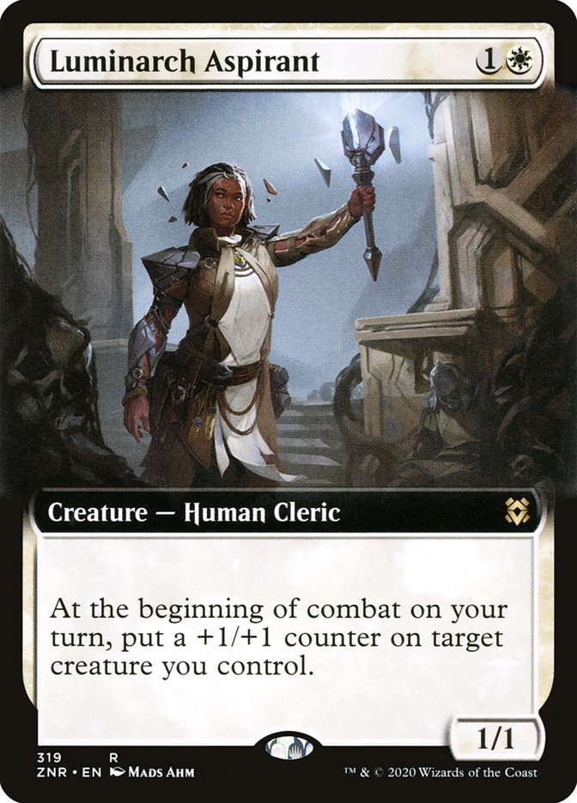
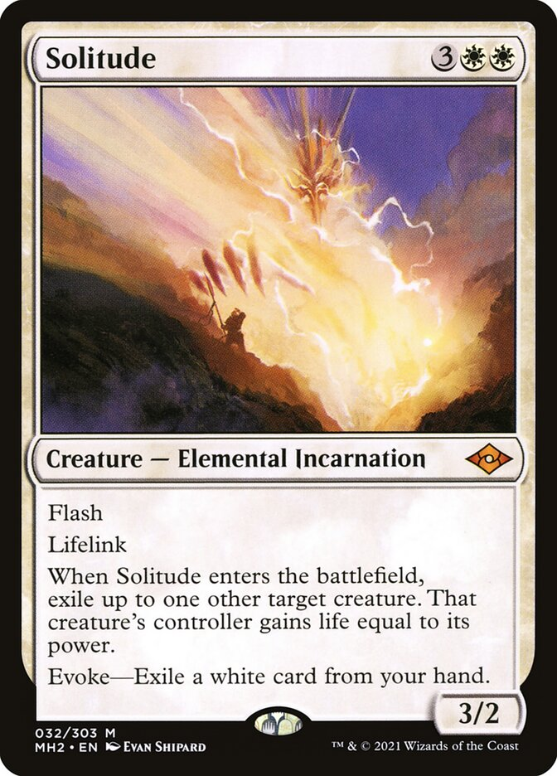
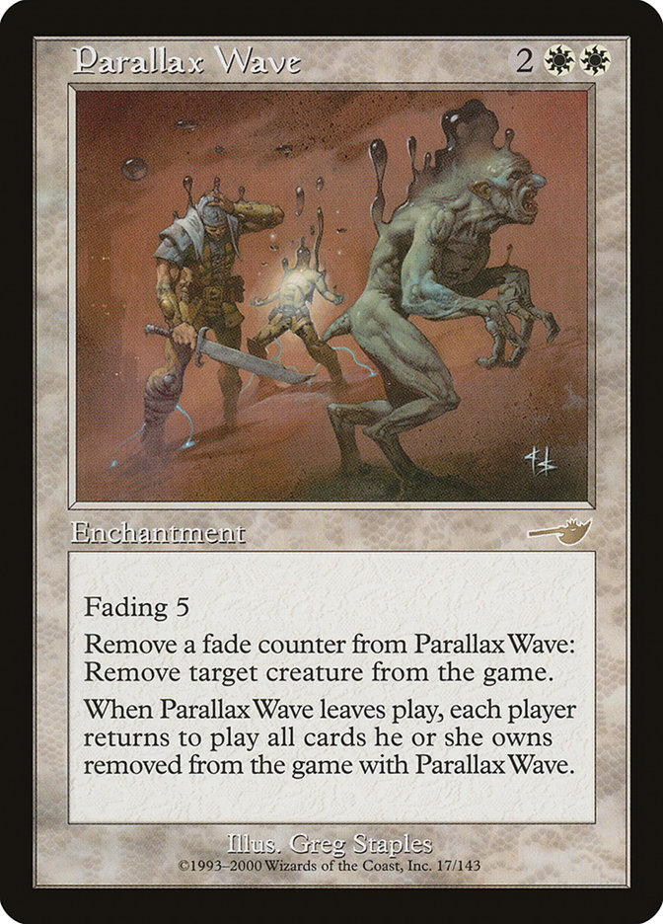
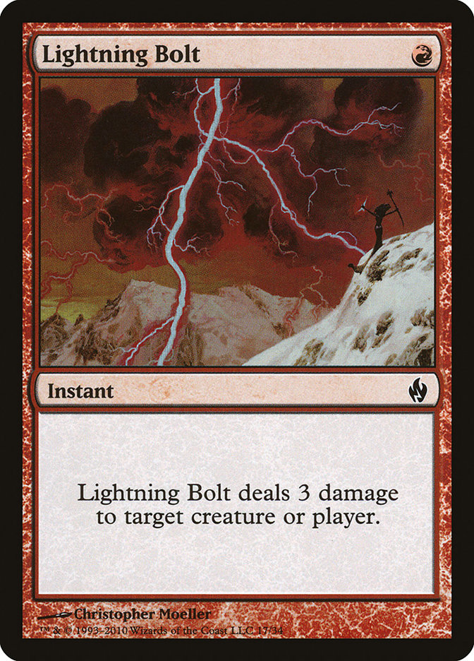
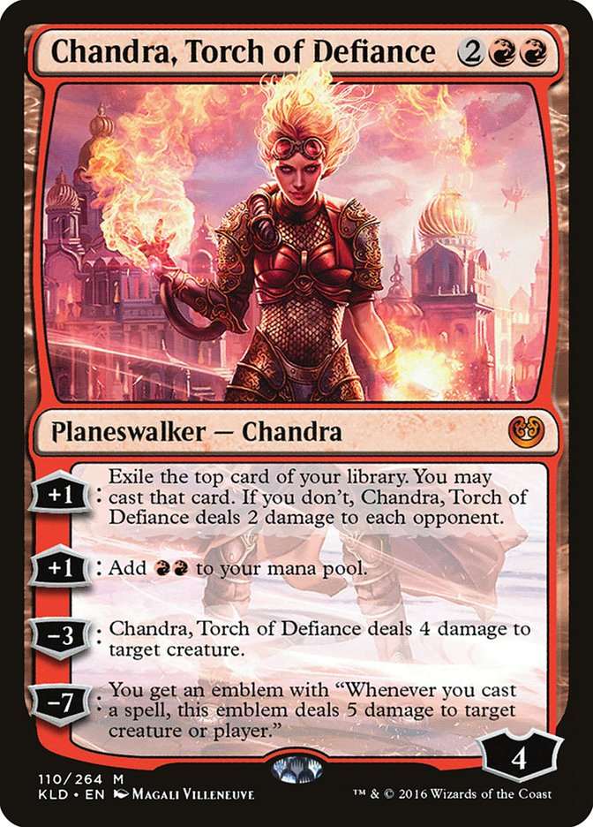
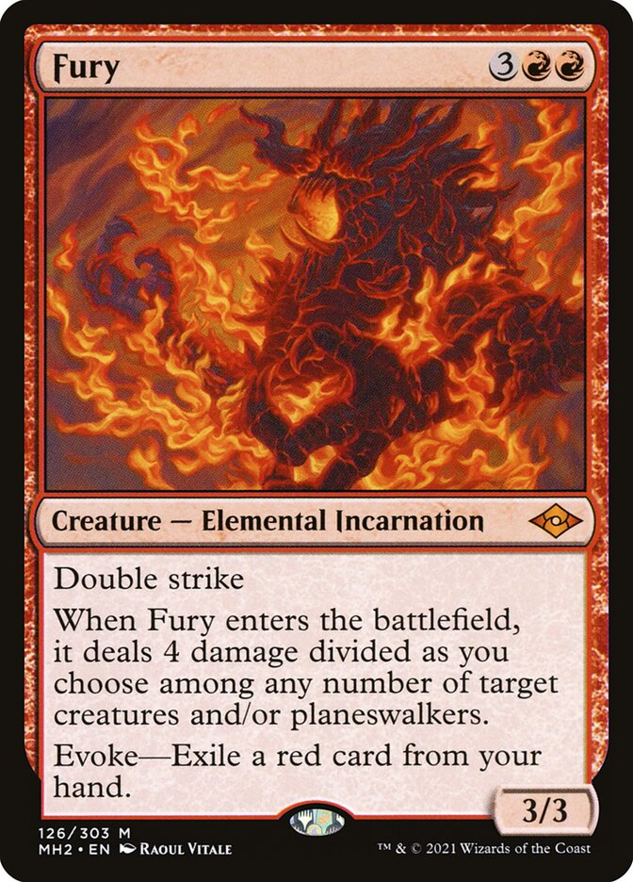
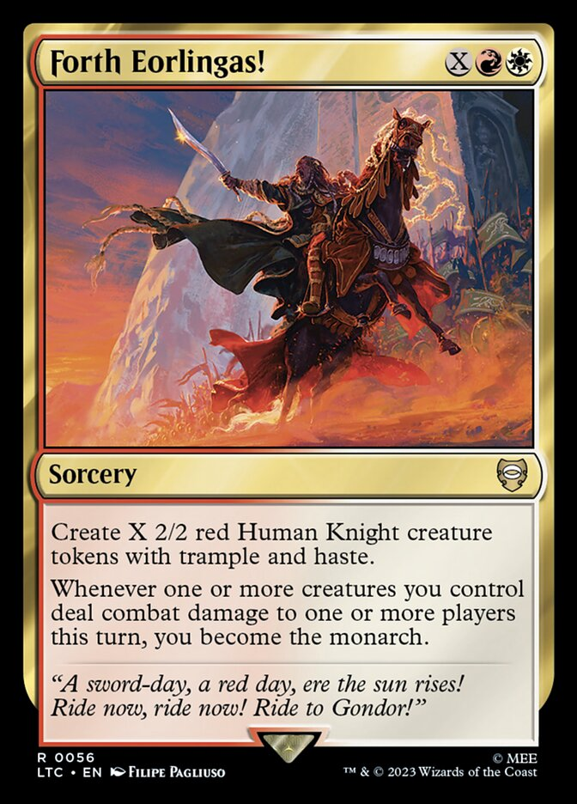
White-based Aggro
Archetype Objective:
Pressure your opponent with cheap creatures and efficient removal.
Utilize white ‘toolbox’ creatures to disrupt your opponent’s gameplan.
Combine with black for additional removal, hand disruption, and card draw.
Combine with red for burn spells and powerful expensive threats.

Slide 4

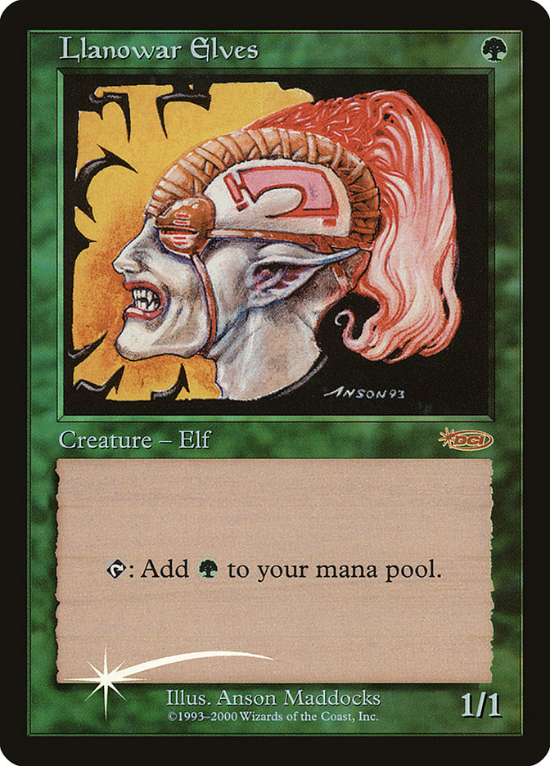
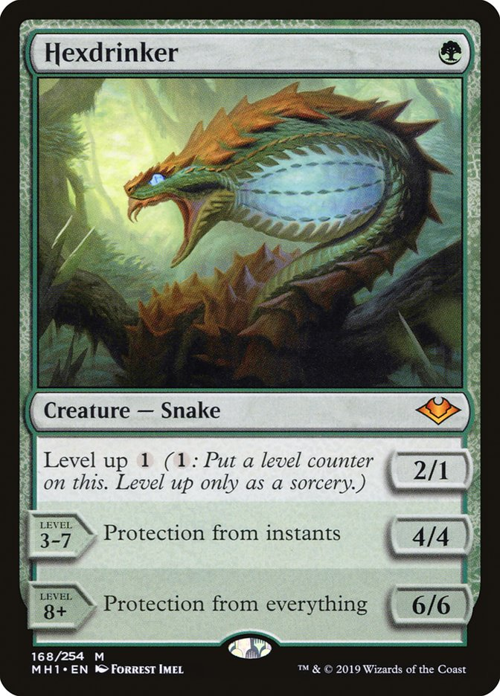
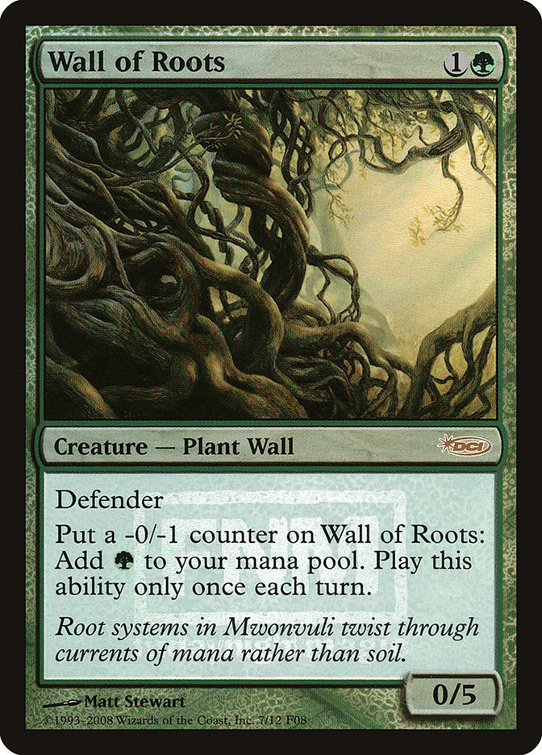
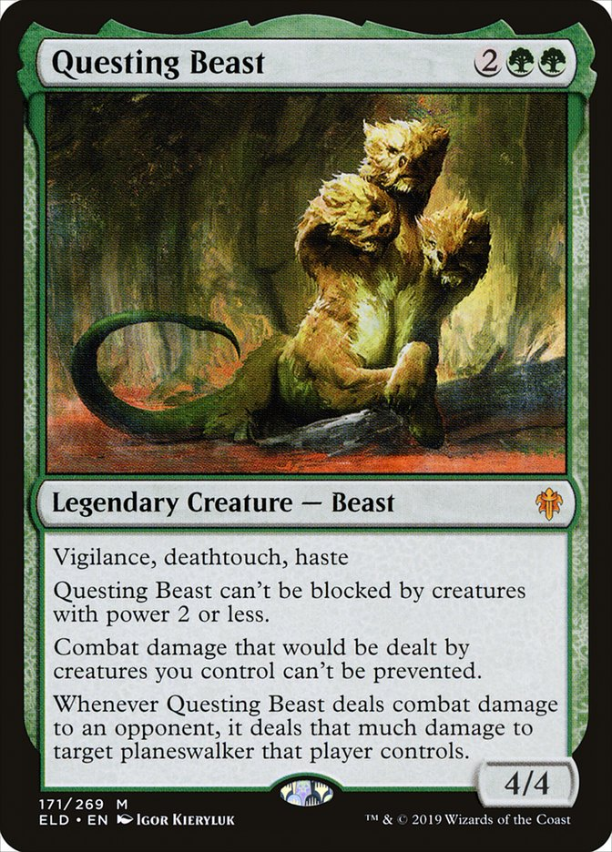
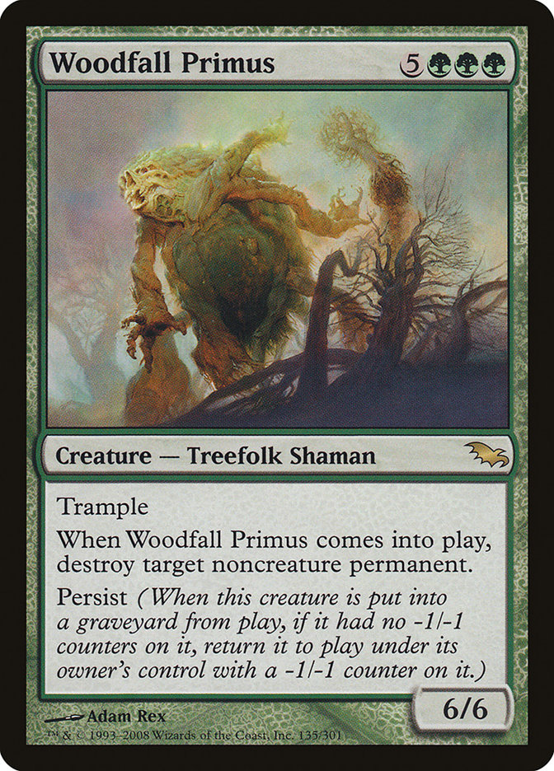
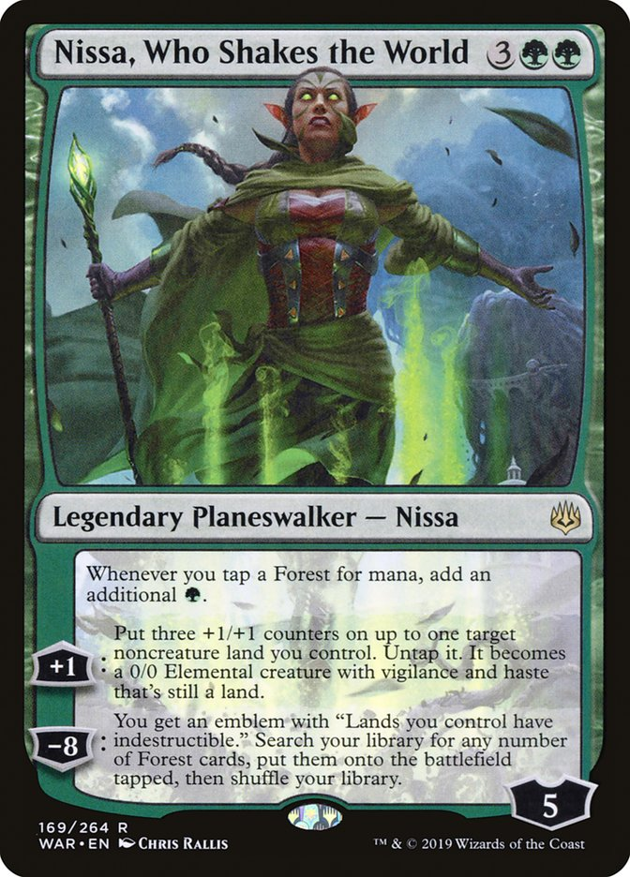
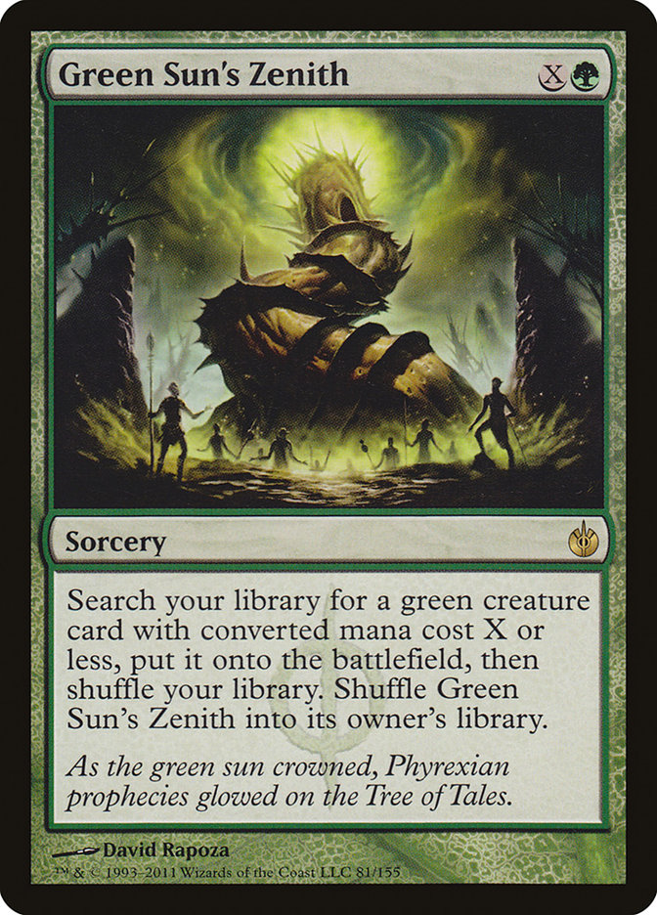
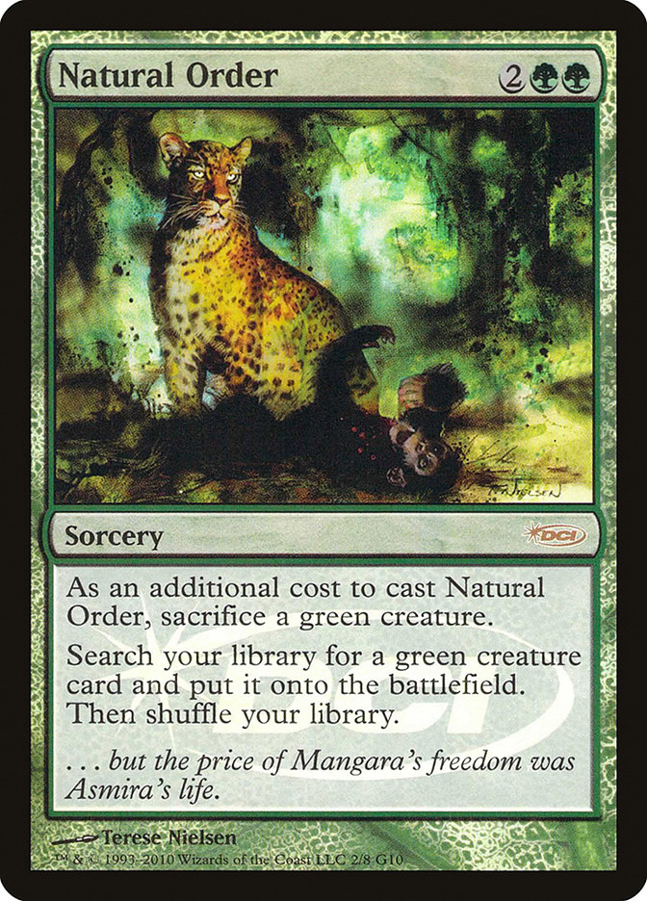
Green Ramp
Archetype Objective:
Use mana-producing creatures to accelerate out threats.
Quickly end the game with powerful creatures or planewalker spells.
Use spells like Natural Order to cheat out powerful green creatures.
Combine with any other color if mono green is not available.

Slide 5

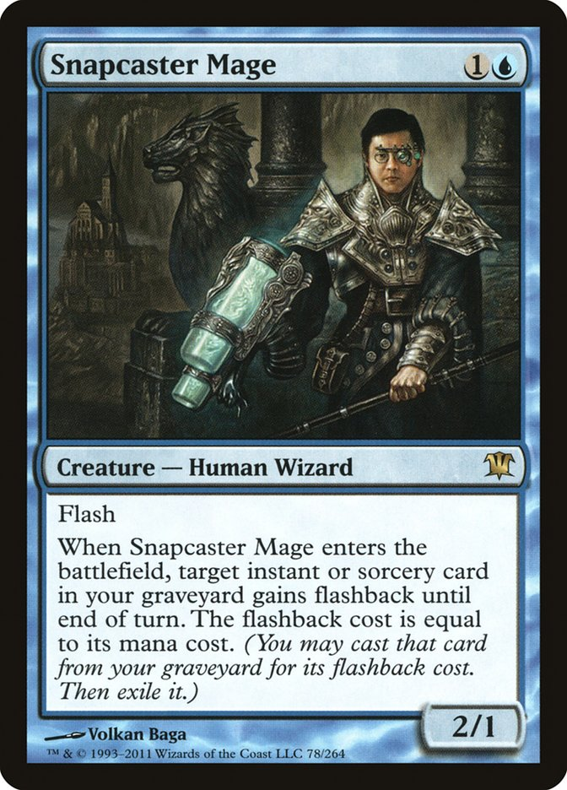
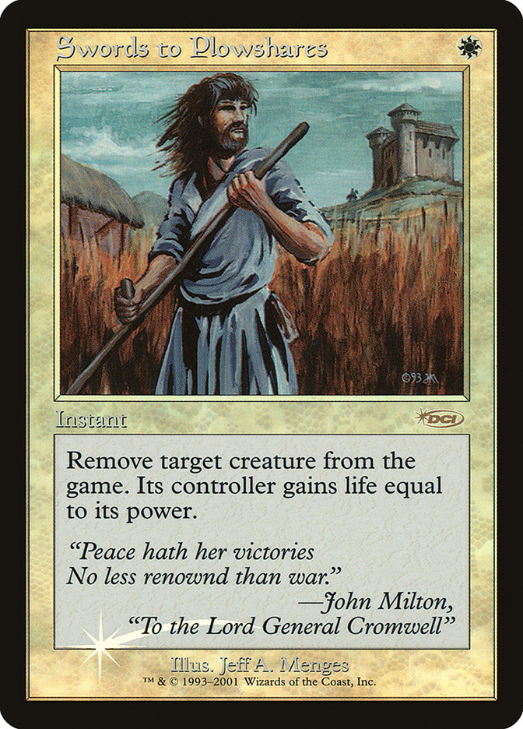
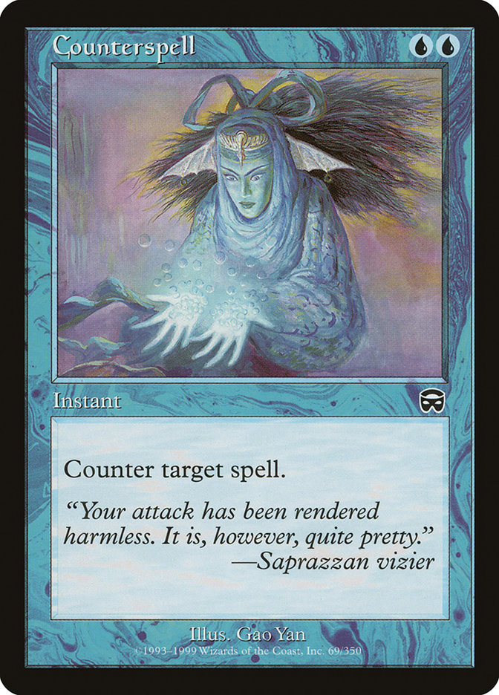
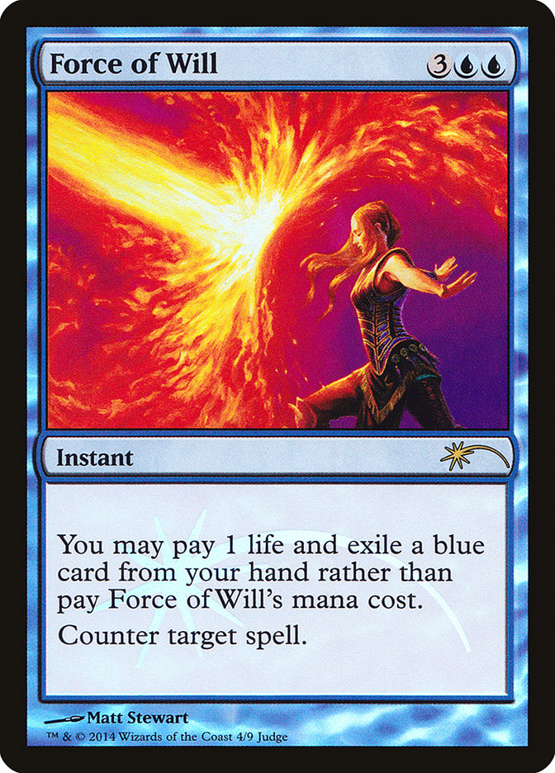
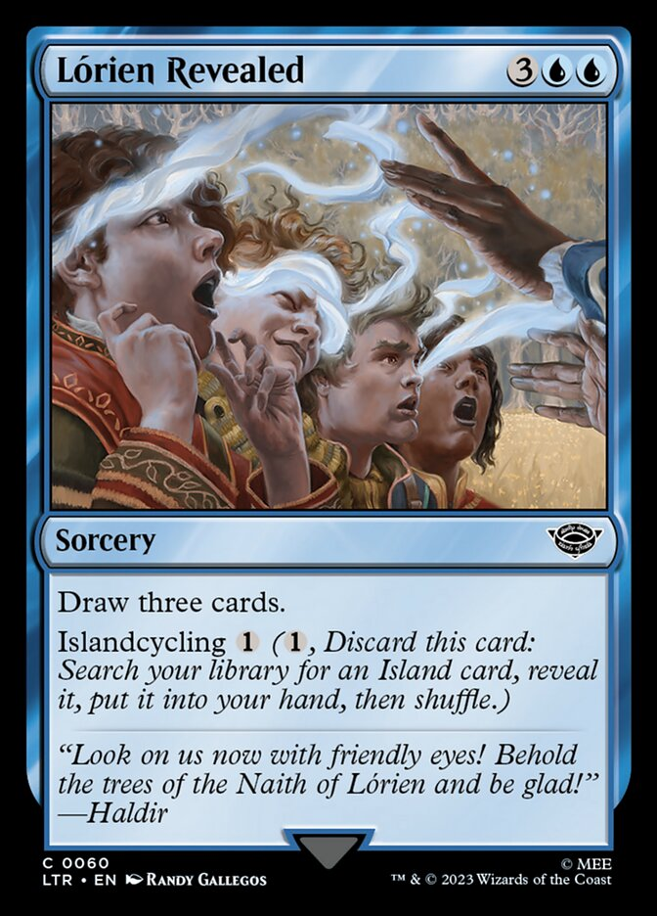
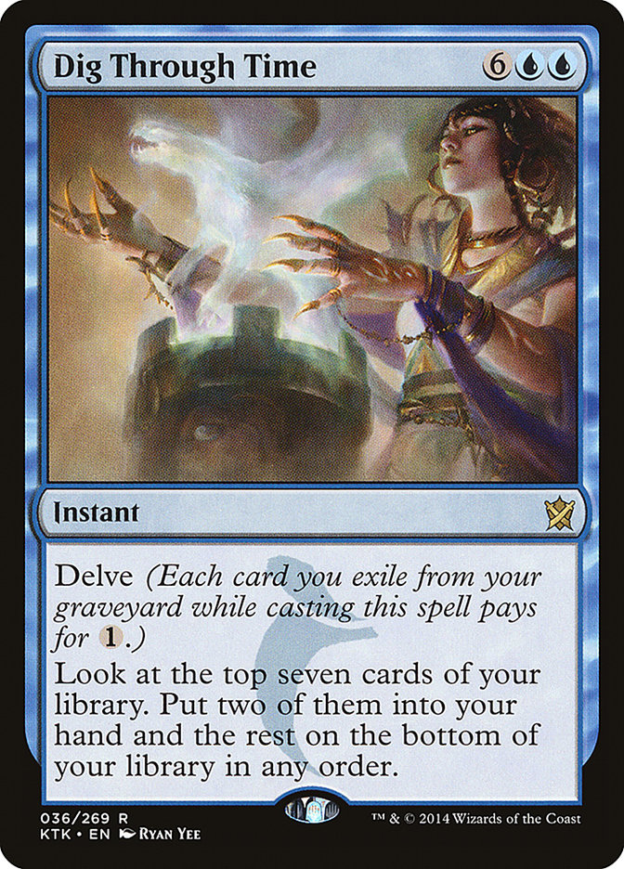
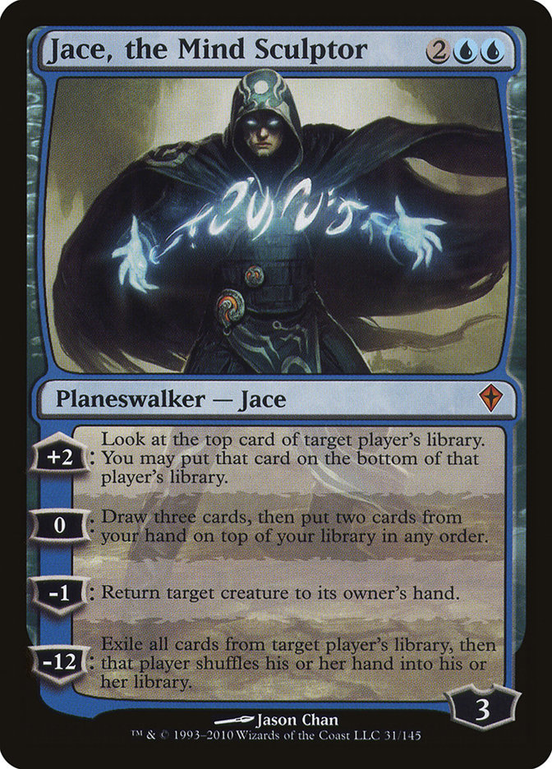
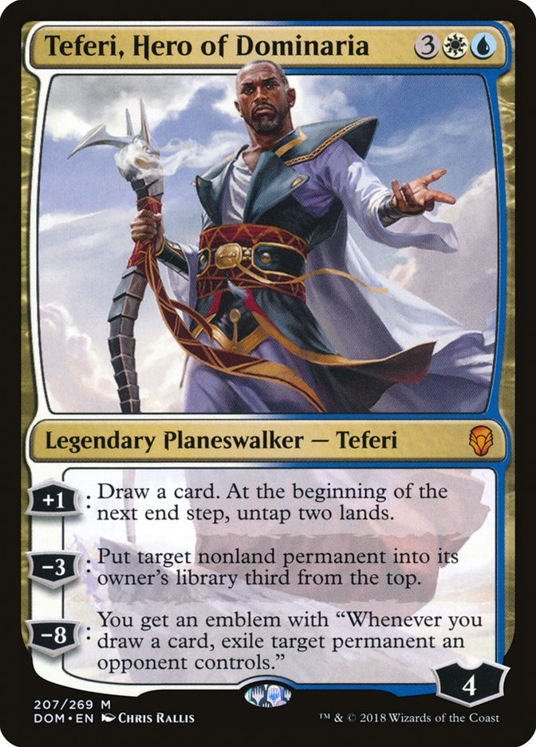
Blue-based Control
Archetype Objective:
Utilize efficient removal and counterspells to slow down the pace of the game.
Once stabilized, end the game with powerful planeswalker spells.
Combine with white for board wipes and flexible creatures.
Combine with black for hand disruption and spot removal.

Slide 6
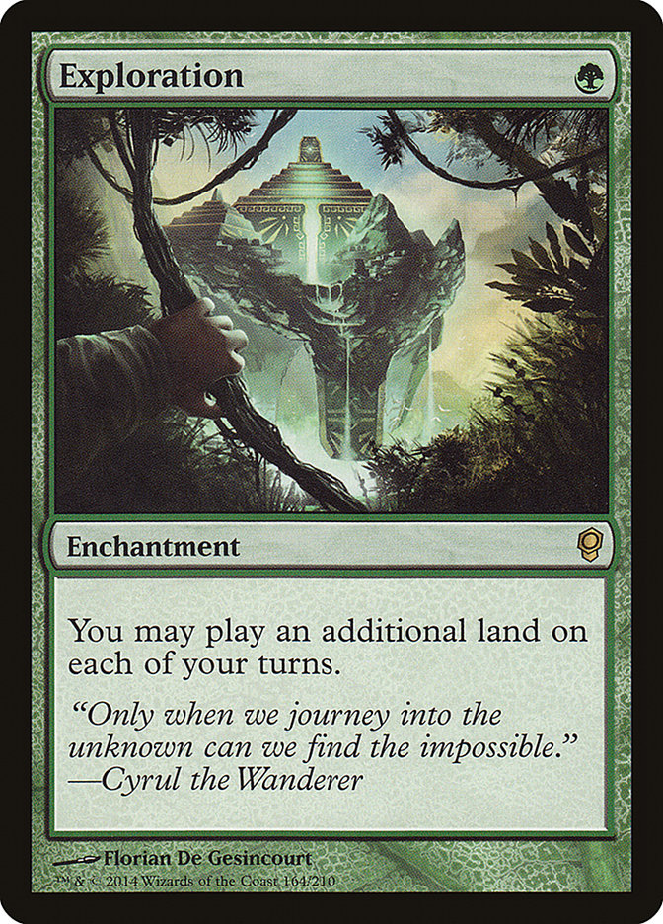
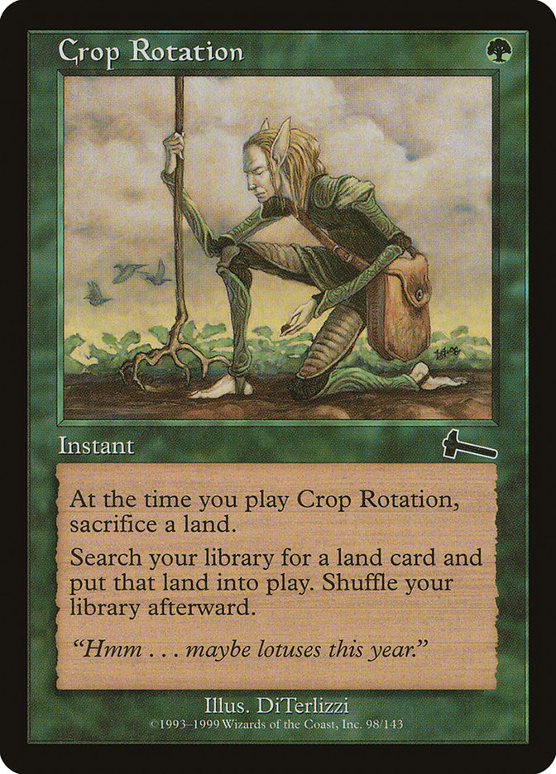
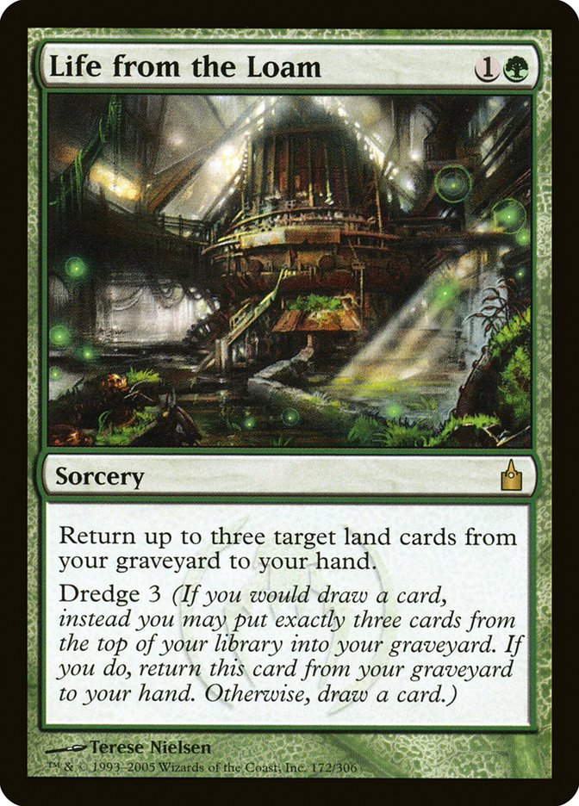
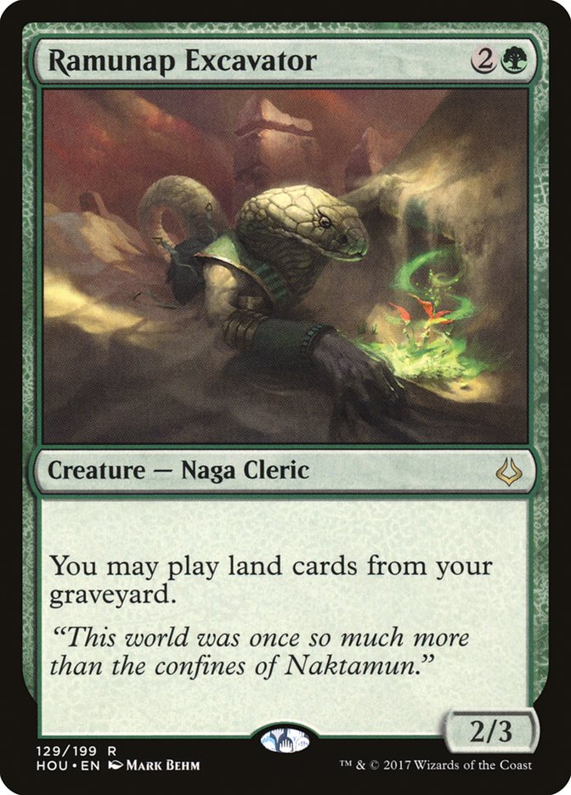
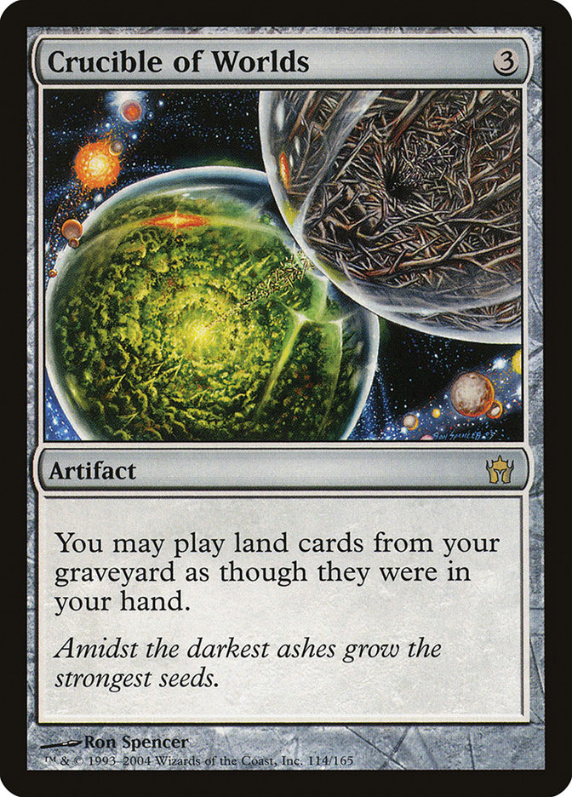
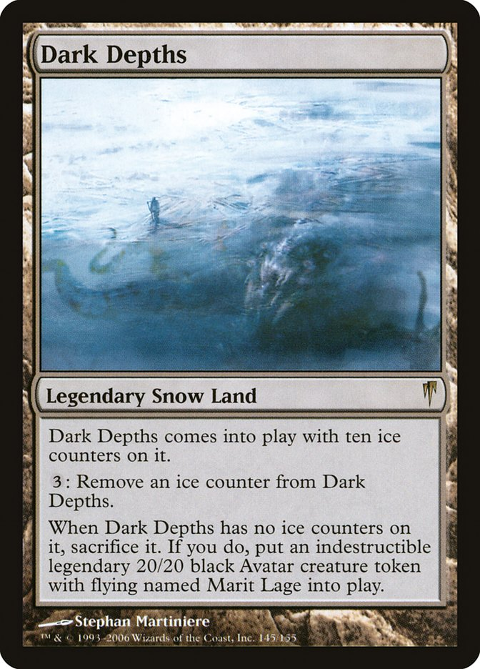
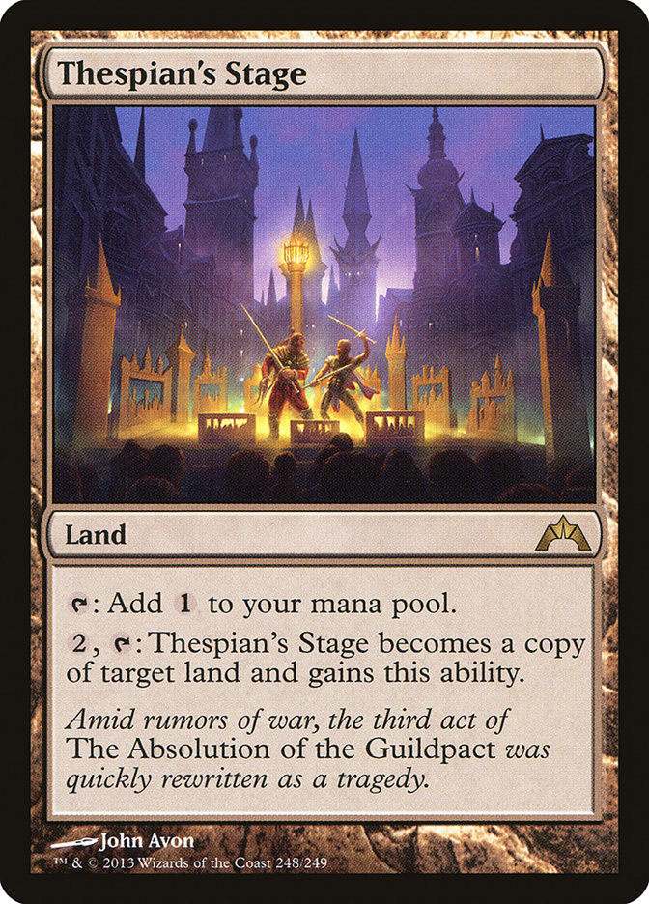
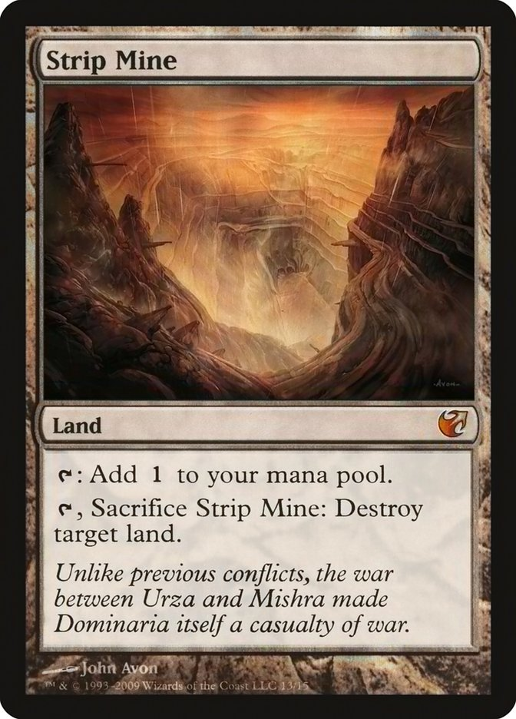
Lands
Archetype Objective:
Accelerate your mana with cards that allow you to play additional lands.
Disrupt your opponent’s mana base with land destruction abilities.
Recur land destruction lands with cards that allow you to play lands from the graveyard.
End the game with large creatures or combo lands.

Slide 7
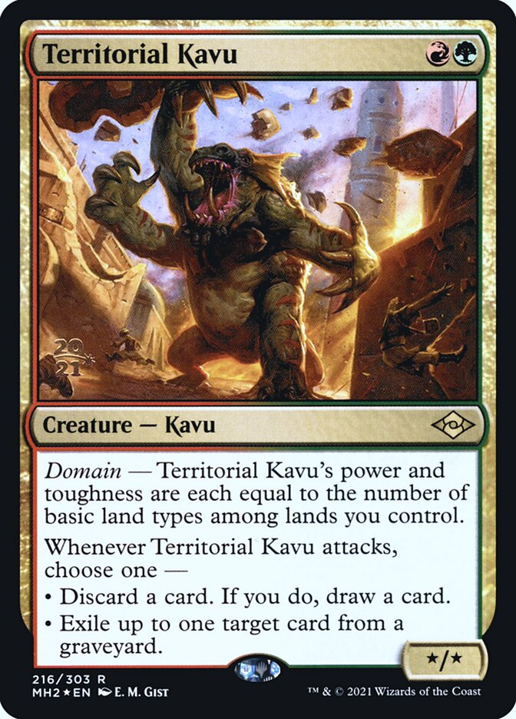
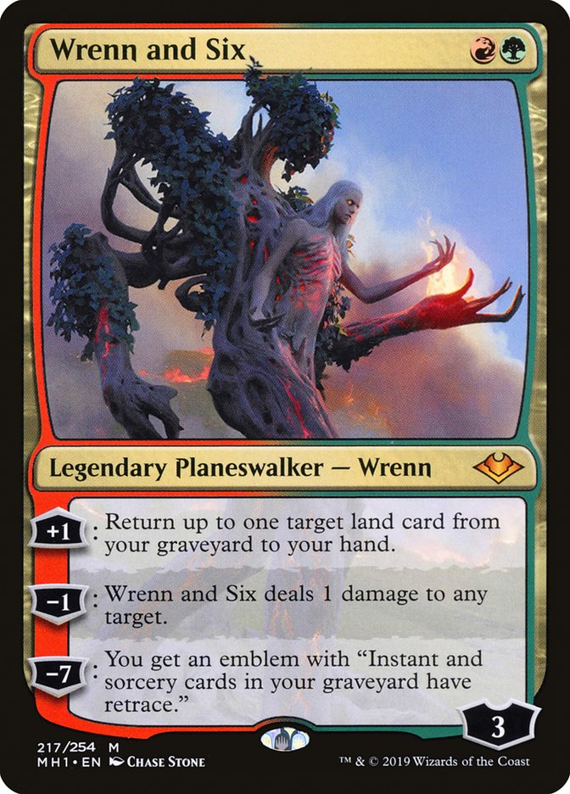
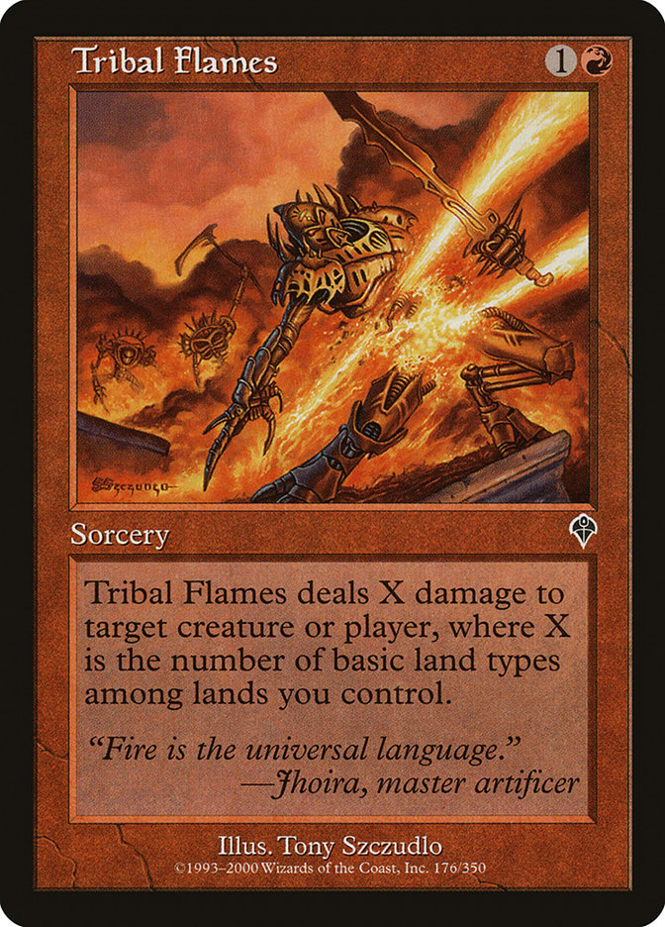
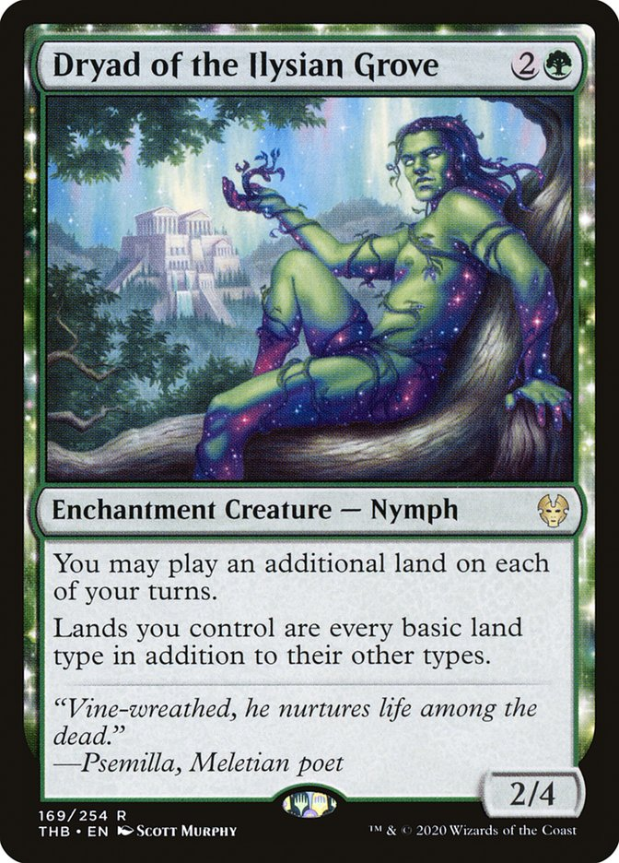
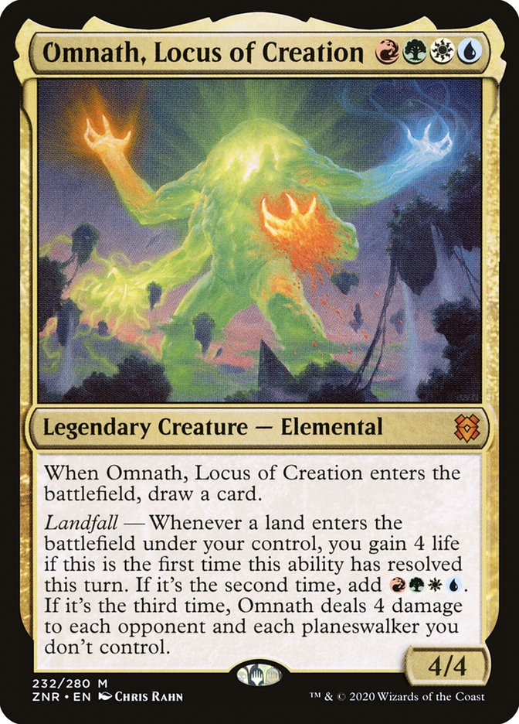
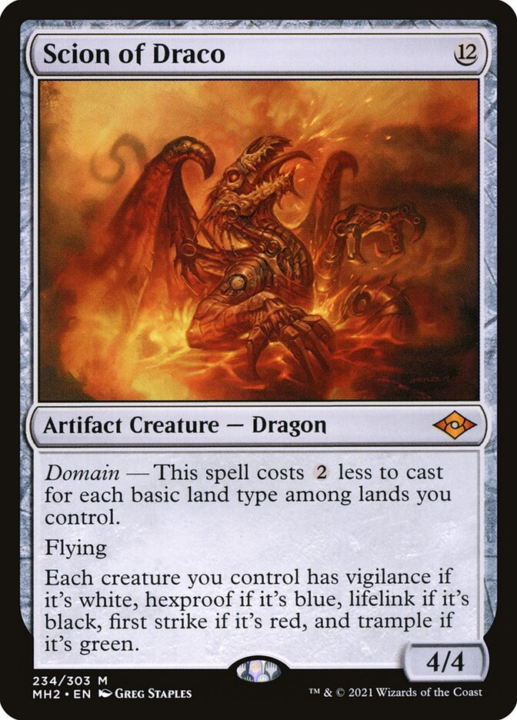
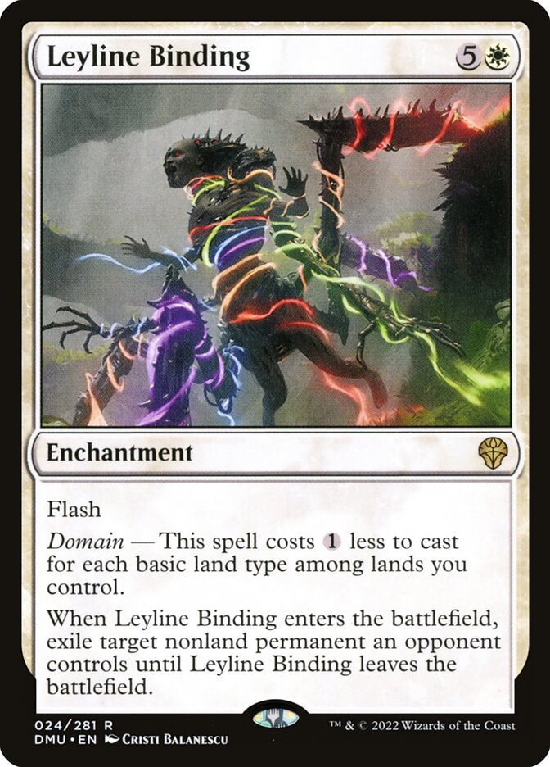
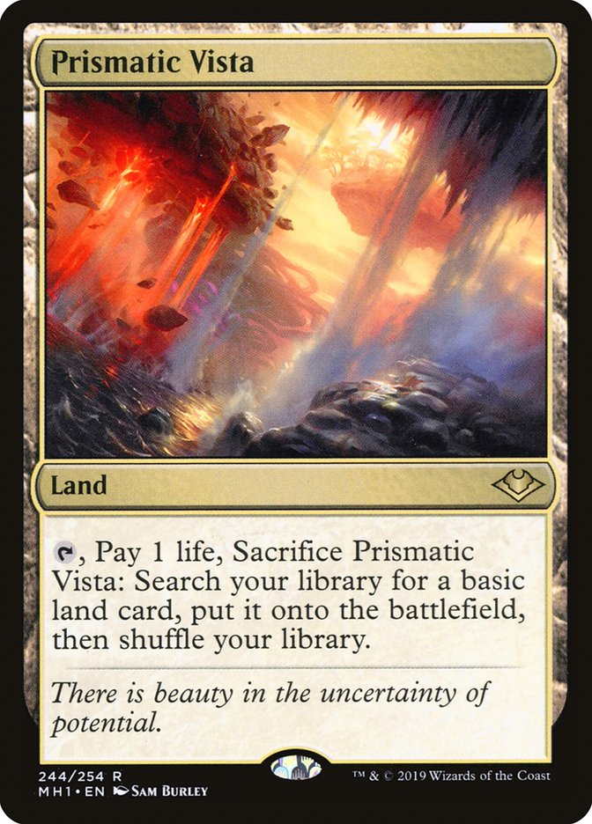
Domain
Archetype Objective:
Prioritize drafting lands to enable a four or five color mana base.
Utilize creatures and spells that become cheaper or benefit from a multi-colored mana base.
Consider cards that help produce multiple colors.
Draft powerful spells from any color that your mana base supports.

Slide 8

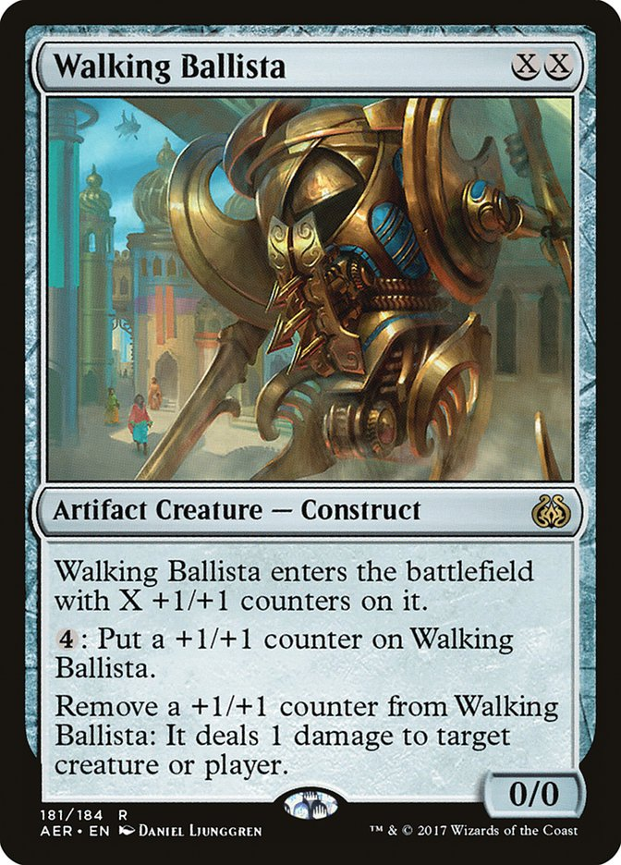
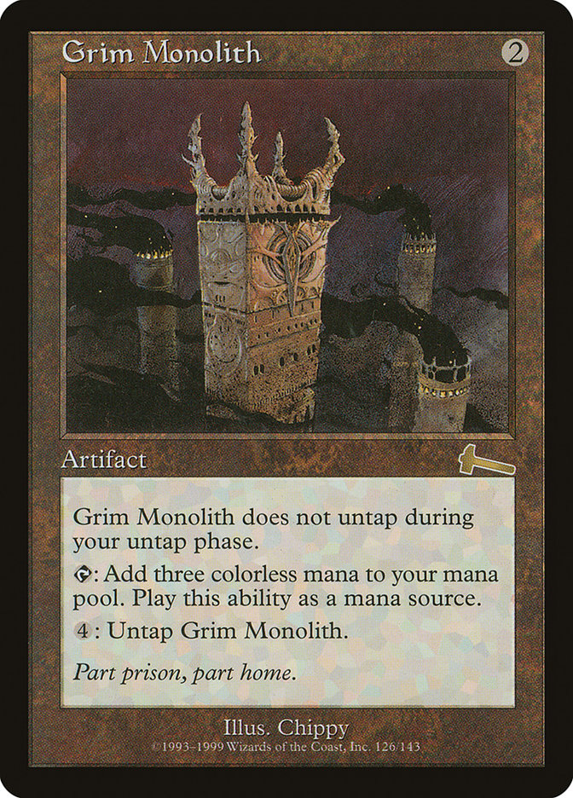
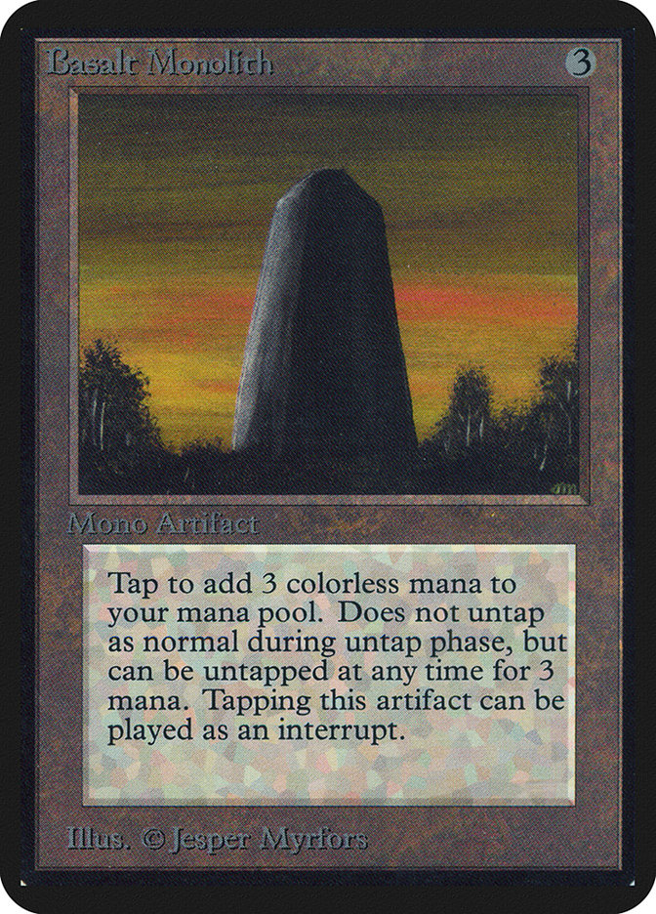
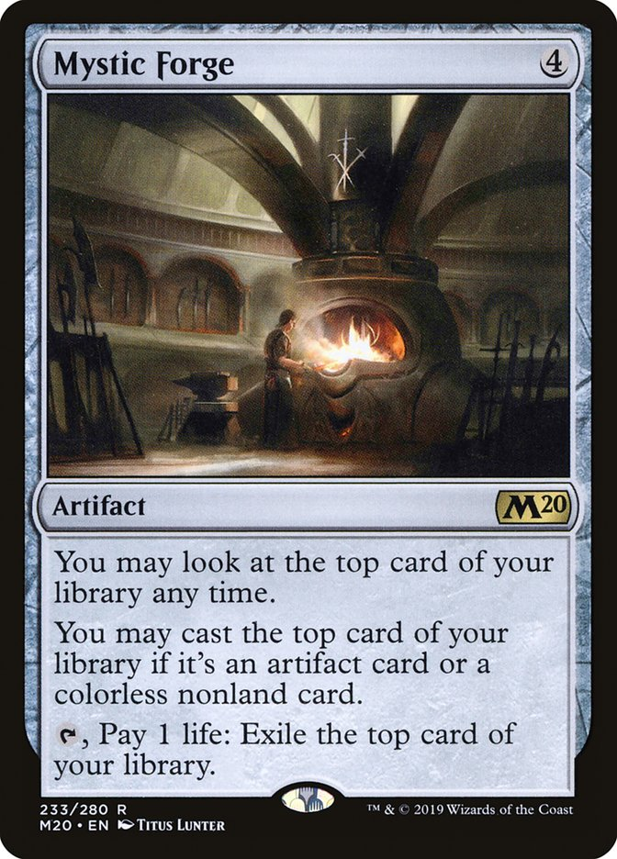
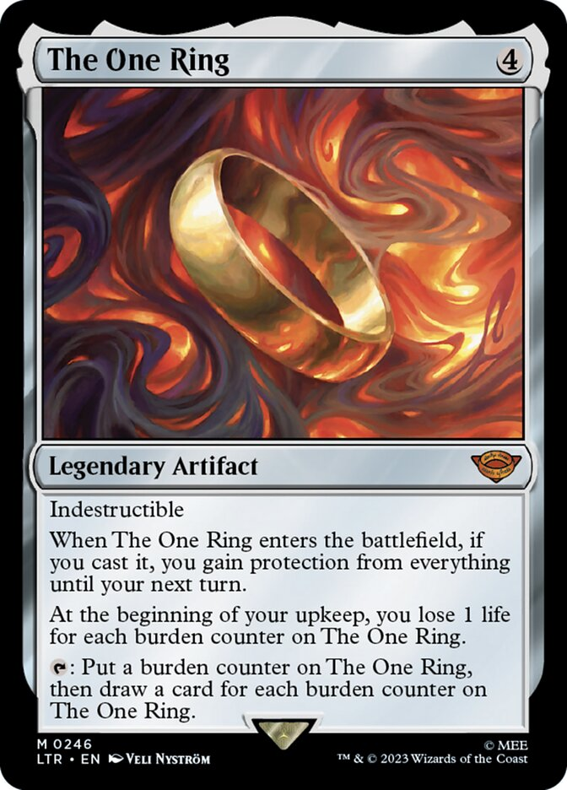
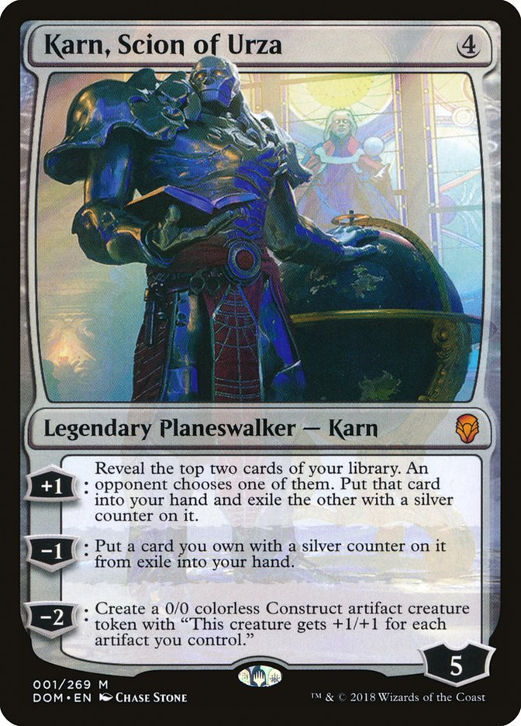
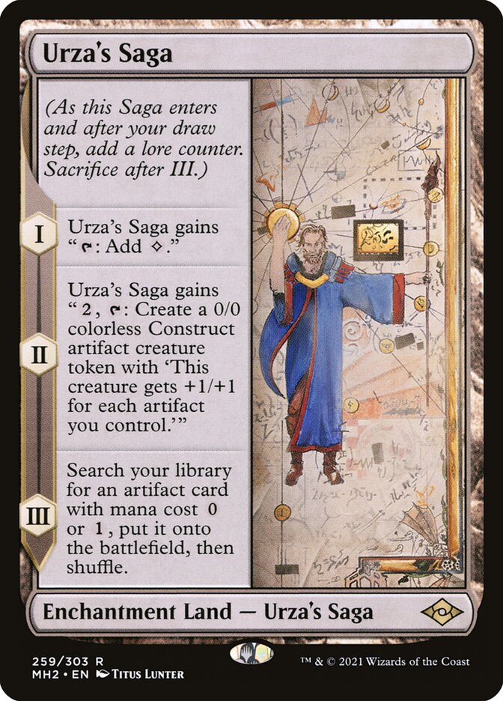
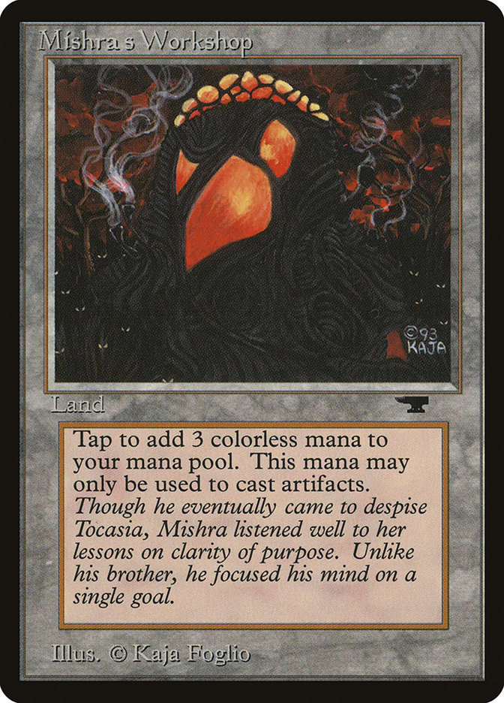
Shops
Archetype Objective:
Use mana rocks to increase mana production.
Use lands that accelerate out artifact spells.
End the game with expensive creatures or artifact construct tokens.
Shops benefits from not having color difficult requirements.

Slide 9
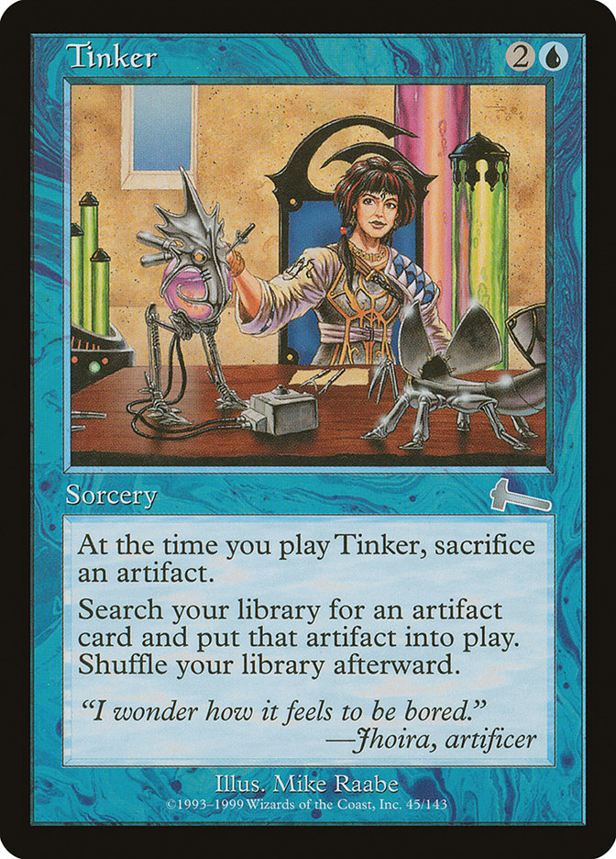






Blue Artifacts
Archetype Objective:
Pair cheap artifacts with cards that benefit from controlling artifacts.
Advance the board with artifact construct tokens or recurring artifact ‘value engines’.
Cheat out expensive artifacts with Tinker.
Combine Tolarian Academy with 0 and 1-cost artifacts.

Slide 10









Reanimator
Archetype Objective:
Win the game by cheating expensive threats from the graveyard onto the battlefield.
Use draw spells and tutors to setup your reanimation combo.
Protect your combo with hand disruption and counterspells.
Combine with either blue or red.

Slide 11








Wheel Combo
Archetype Objective:
Abuse permanents that turn otherwise symmetrical ‘wheel’ effects into favorable or completely lopsided exchanges.
Disrupt your opponent’s gameplan with counterspells and card draw limitation.
End the game by ‘out valuing’ your opponent.

Slide 12







Storm Combo
Archetype Objective:
Draft cheap ‘cantrips’ and mana-producing ‘rituals’ to setup your combo.
Finish off your opponent by casting a spell with ‘storm’ or recurring a burn or mill effect.
Combining Underworld Breach, Lion’s Eye Diamond, and Brain Freeze is a consistent and powerful game-ender.
Combine with red for rituals and wheels, and black for tutors and Yawgmoth’s Will.

Slide 13







Big Creature Combo
Archetype Objective:
Utilize cheap ‘sneak’ effects to cheat out powerful expensive creatures.
Use card draw and tutor spells to setup your combos.
Consider utilizing multiple ‘sneak’ effects for better consistency.
Often base blue, big creature combo decks can also include green, red, or black.

Slide 14









Notable Recent Additions

